Slide 1
ALIGNING CATEGORY CHOICES WITH ENGAGEMENT GOALS FOR MAXIMUM ROI

Slide 2
WHICH CATEGORY INFLUENCERS YIELDS THE MAXIMUM ROI IN TERMS OF ENGAGEMENT
Maximum Engagement
Better ROI (Return Of Investment)
Targeted Strategy
Decision Making

Slide 3
METHODOLOGY
NATURAL LANGUAGE PROCESSING
SENTIMENT ANALYSIS
5 CATEGORIES
TRENDING KEYWORDS
NATURAL LANGUAGE TOOLKIT (NLTK)
TEXTBLOB

Slide 4
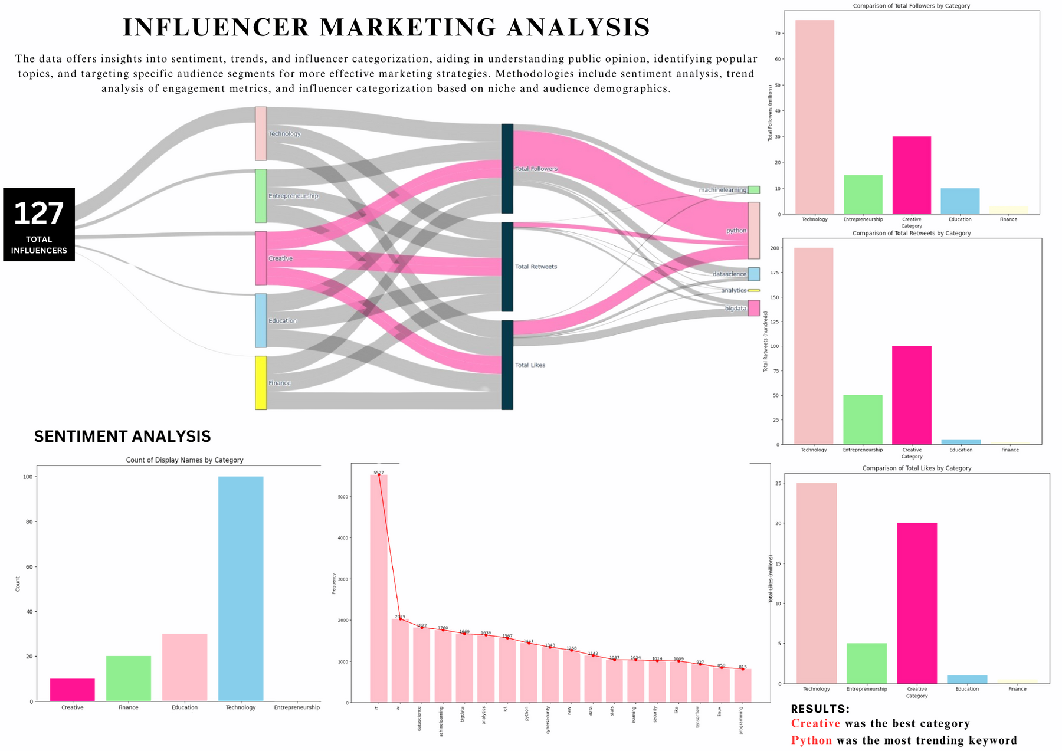

Slide 5
CONCLUSION
Creative category is the one that gave us the highest ROI.
PYTHON is the keyword that was found to be the most engaging.

